Slide 1
Monoids and Machines
Homomorphism of Algebras

Slide 2
Homomorphism of Algebras
First consider in general;
  Consider two algebras
  A = ( A, F_{A}; P_{A} ) ; B = (B; F_{B}; P_{B} )
  Such that (F_{A} ↔ F_{B}) and (P_{A} ↔ P_{B}) then
  without assuming either injectivity or
  surjectivity, we can call a mapping ϕ : A → B
  homomorphism if
  ϕ f_{A}(a₁,a₂, …, a_{n}) = f_{B} (ϕa₁, ϕa₂ , … , ϕa_{n} )
      For every operation ‘ f ’ and
  (a₁,a₂, …, a_{n}) ∈P_{A} ⬄ (ϕa₁, ϕa₂ , … , ϕa_{n} ) ∈ P_{B}
    for every proposition P

Slide 3
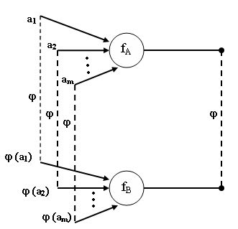
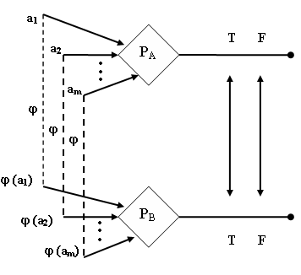
Homomorphism of Algebras

Slide 4
Homomorphism of Algebras
A homomorphism ϕ : A → B is said to be injective (respectively surjective) if the underlying mapping is injective (surjective).
A bijective (injective and surjective) homomorphism is called an isomorphism (A ~ B)

Slide 5
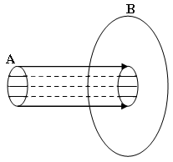
Homomorphism of Algebras
When the homomorphism ϕ : A → B is injective then we say that B realizes A

Slide 6
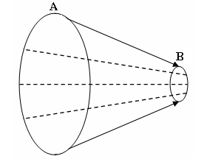
Homomorphism of Algebras
When the homomorphism ϕ : A → B is surjective then we say that “B is a homomorphic image of A”

Slide 7
Homomorphism of Algebras
Example-1
  In case of graphs G = (V,E); there is no operation and just one (binary) proposition; the edge relation E. The idea of graph isomorphism also satisfies the idea presented here.
  v E₁ w ⬄ (ϕv) E₂ (ϕw)

Slide 8
Homomorphism of Algebras
Example-2
  A monoid has no propositions, but it has two operations. There is a binary operation; and there is a nullury operation that is distinguishes the identity element. So if (M,*,e) and (M′,•,e′) are monoids, then the mapping ϕ:M → M′ is monoid homomorphism provided that
    ϕ(e) = e′
    ϕ(x*y) = ϕ(x) • ϕ(y) for all x, y in M

Slide 9
Homomorphism of Algebras
Example-3
  Z = (Z, + , 0) and B = (B, ,0)
  are monoids, and we can show that the mapping ϕ : Z → B, namely
  ϕ(n) = 0 if n is even
  1 if n is odd
  is a surjective monoid homomorphism.
  Since ‘0’ is even so it assures the identity element condition, i.e. ϕ(e) = e′

Slide 10
Homomorphism of Algebras
The condition (ii)
  ϕ(n+m) = ϕ(n) ϕ(m)
can be verified by the table.
If ‘n’ and ‘m’ are both even, then ‘n+m’ is also even.
  ϕ(n+m) = 0 = 0 0
  = ϕ(n) ϕ(m)
n | m
Even | Even
Even | Odd
Odd | Even
Odd | Odd

Slide 11
Homomorphism of Algebras
Consider the monoids M=(M,*, e) and M′=(M′,•, E)
* | e | a | b | c
e | e | a | b | c
a | a | e | c | b
b | b | b | b | b
c | c | c | c | c
• | E | B
E | E | B
B | B | B

Slide 12
Homomorphism of Algebras
The mapping
  e → E
  a → E
  b → B
  b → B
Is a surjective monoid homomorphism ϕ:M→M ′ , for we have
  ϕ(e) = E
  ϕ(a*b) = ϕ(c) = B = E • B = ϕ(a) • ϕ(b)
  ϕ(b*a) = ϕ(b) = B = B • E = ϕ(b) • ϕ(a), etc ...

Slide 13
Homomorphism of Algebras
Example-4
  Transformation monoid T₄ realizes the monoid T=(T, ο , I_{s} )
  where T = {T₁,T₂,T₃,T₄,T₅,T₆,T₇,T₈}

Slide 14
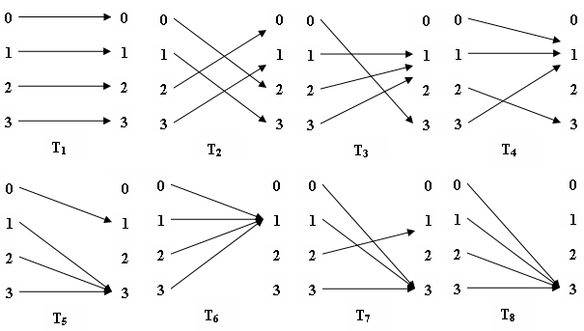
Homomorphism of Algebras

Slide 15
Homomorphism of Algebras
Example-5
  In view of the identities, we can say that T is generated by the subset X = {T_{2 ,}, T₃ }
    T₁ =T₂ ο T₂
    T₄ =T₂ ο T₃
    T₅ =T₃ ο T₂
    T₆ =T₃ ο T₃
    T₇ =T₂ ο T₅ =T₂ ο T₃ ο T₂
    T₈ =T₃ ο T₅ =T₃ ο T₃ ο T₂

Slide 16
Homomorphism of Algebras
A monoid homomorphism is ϕ : T→M {M=(M,*,e)} is completely determined by the images ϕ(T₂) and ϕ(T₃) just because T₂ and T₃ generate T. Thus
  ϕ(T₁) = ϕ(T₂ οT₂ ) = ϕ(T₂) *ϕ(T₂ )
  ϕ(T₄) = ϕ(T₂ οT₃ ) = ϕ(T₂) *ϕ(T₃ ) etc…
On the other hand if we assign images
  T₂ → ϕ(T₂ )
  T₃ → ϕ(T₃ )

Slide 17
Homomorphism of Algebras
Transformation Monoid
M = (M,*,e)
* | e | a | b | c
e | e | a | b | c
a | a | e | c | b
b | b | b | b | b
c | c | c | c | c

Slide 18
Homomorphism of Algebras
In a given monoid M, then there may or may not be an extension to a homomorphism ϕ : T→M .
T₂ → b
Then we should have
  b = b*b=ϕ(T₂)*ϕ(T₂)=ϕ(T₂ ο T₂ )=ϕ(T₂) = e
which is a contradiction.

Slide 19
Homomorphism of Algebras
Free Algebras
  One that is free of any identities except those implied by the axioms, any mapping of the generators into a similar algebra will admit a unique extension to a homomorphism.

Slide 20
Homomorphism of Algebras
  The algebra A is freely generated by the elements of the finite subset (the set of generators)
  X= {x₁,x₂,…,x_{n}} ⊆ A
    Every x ∈ A has a representation as an algebraic expression in the elements x₁,x₂,…,x_{n};
    Every mapping ϕ : X → B of the generators into a similar algebra B has an extension to the homomorphism ϕ : A → B

Slide 21
Homomorphism of Algebras
The Natural numbers N = (N, +, 0) are an example of a free monoid – free on one generator.

Slide 22
Homomorphism of Algebras
Taking X={1}, we can verify the two conditions:
  Every n∈N has a representation as an algebraic expression n=1+1+…+1 (n times), ‘0’ is considered as an empty expression
  If M is any monoid and we assign ϕ(1) in M, then the extension ϕ : A → B is given by
  ϕ(n) = ϕ(1) + ϕ (1) + . . . + ϕ (1) (n times)
= n * ϕ (1)

Slide 23
Homomorphism of Algebras
Assuming that M is denoted additively M = (M,+,0), for we can then verify the conditions for a monoid homomorphism
  ϕ(0) = 0* ϕ(1) = 0
  ϕ(n+m) = (n+m)* ϕ(1) = n ϕ(1) +m ϕ(1)
  = ϕ(n) + ϕ (m)

